Slide 1


Python Coding Session Functions
Introduction to Implementation Details and Usage

Slide 2

Introduction
Functions in Python are reusable blocks of code that perform a specific task. They help in organizing code, making it more modular, and reducing code duplication.

Slide 3
Python Functions

Slide 4
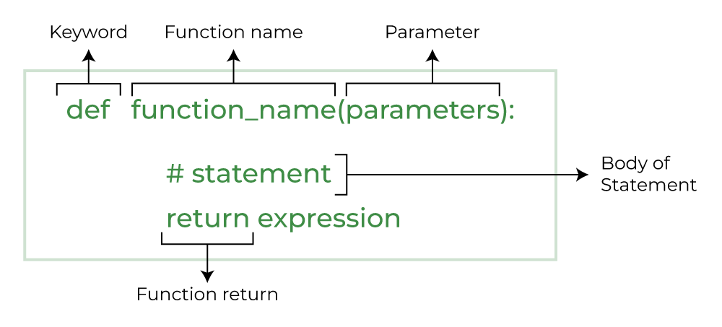
Structure of a Function

Slide 5
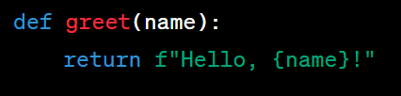
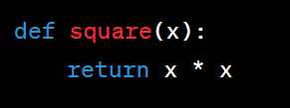

Examples of Functions
Function that returns one string
Function that returns the square of a number
Function that returns sum of two numbers

Slide 6

How to call a function

Slide 7
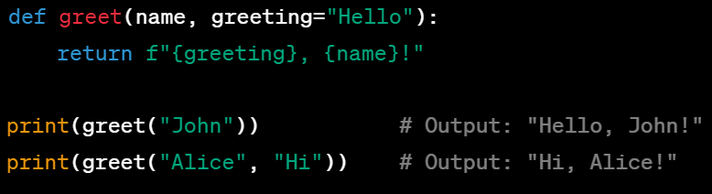
Default Arguments

Slide 8
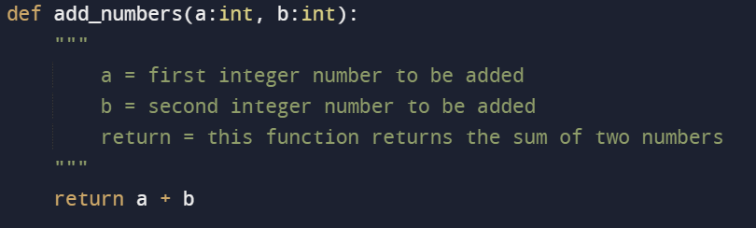
Good Pratices: Types and Doc strings

Slide 9
Pratice
Exercise: Add Numbers Write a function that takes two numbers as input and returns their sum.
Exercise: Find the Maximum Write a function that takes a list of numbers as input and returns the maximum value in the list.
Exercise: Calculate Factorial Write a function to calculate the factorial of a given number using recursion.
Exercise: Count Vowels Write a function that takes a string as input and returns the count of vowels (a, e, i, o, u) in the string.

